Slide 1

Universal Application Development on Windows Platform for Beginners Intro to the Course
Dmitry Soshnikov
dmitryso@microsoft.com | twitter.com/shwars | blog.soshnikov.com
Microsoft

Slide 2

THE WORLD OF TECHNOLOGY
THE WORLD OF OPPORTUNITIES
Notes:
Значительную роль в формировании будущего теперь играют всевозможные устройства и технологии, связывающие их в единую сеть.

Slide 3
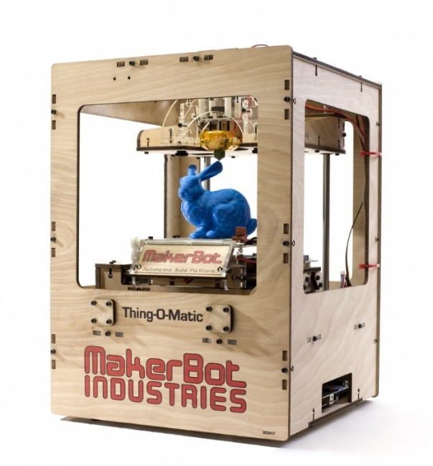
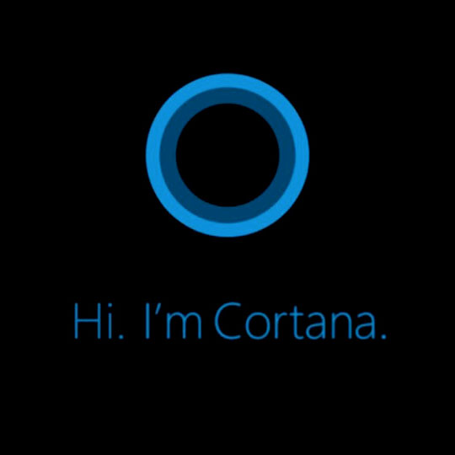

Programmers in today’s world
Knowing how to use computer is no longer an advantage
Easy to bring your ideas to life and to consumers due to marketplaces/ Internet
You can do virtually anything with modern digital production

Slide 4
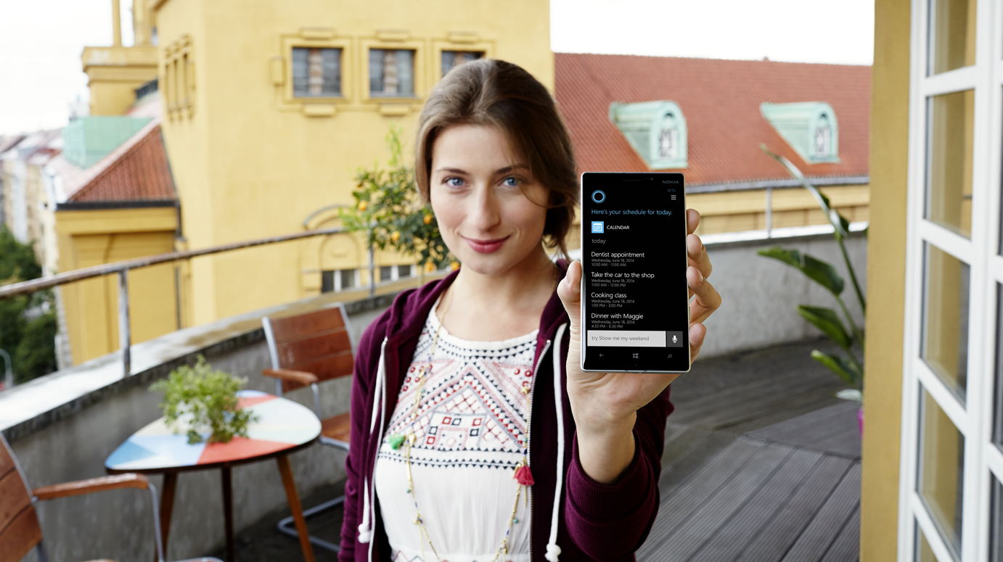
NEW WORLD
MOBILE
MOBILITY OF PEOPLE, DEVICES, EXPERIENCES and INTERACTIONS
CLOUD
CLOUD GLUES ALL PARTS OF THE ECOSYSTEM TOGETHER, PROVIDING INTELLIGENT AMBIENT SERVICES
Notes:
Мобильность: важный акцент на мобильность опыта взаимодействия между ВСЕМИ устройствами. Окружение человека и устройства меняются, важно, чтобы он мог решать свои задачи с наиболее подходящими устройствами в каждый момент времени, будь это работа, развлечение или любой другой момент жизни, выбирая в том числе наиболее удобный способ взаимодействия.
Облако: не просто ресурсы, но и новые бизнес-процессы, мы хотим построить умное облако.

Slide 5
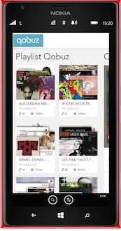
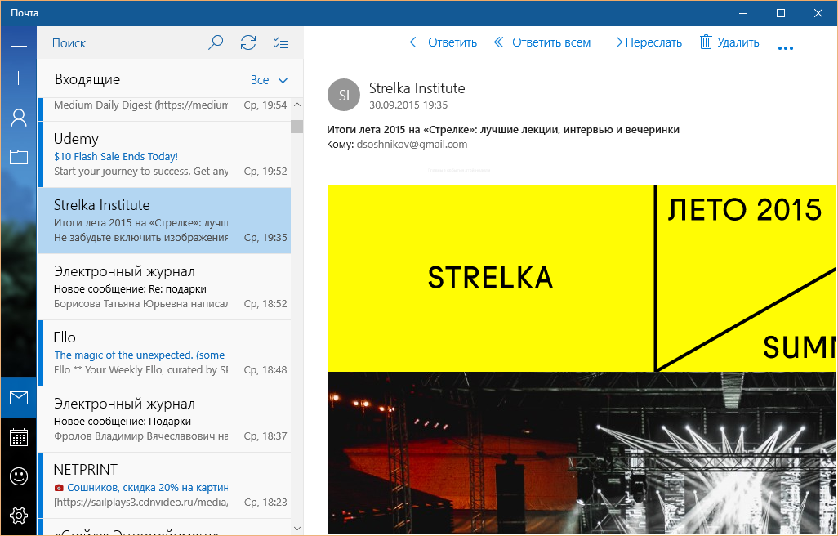
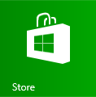

Applications in the Modern World
Work on all platforms: PC, Tablets, Smartphones, Gaming Consoles, Smart Wearables, …
Software delivered through marketplace of internet services
Smart Cloud connectivity

Slide 6

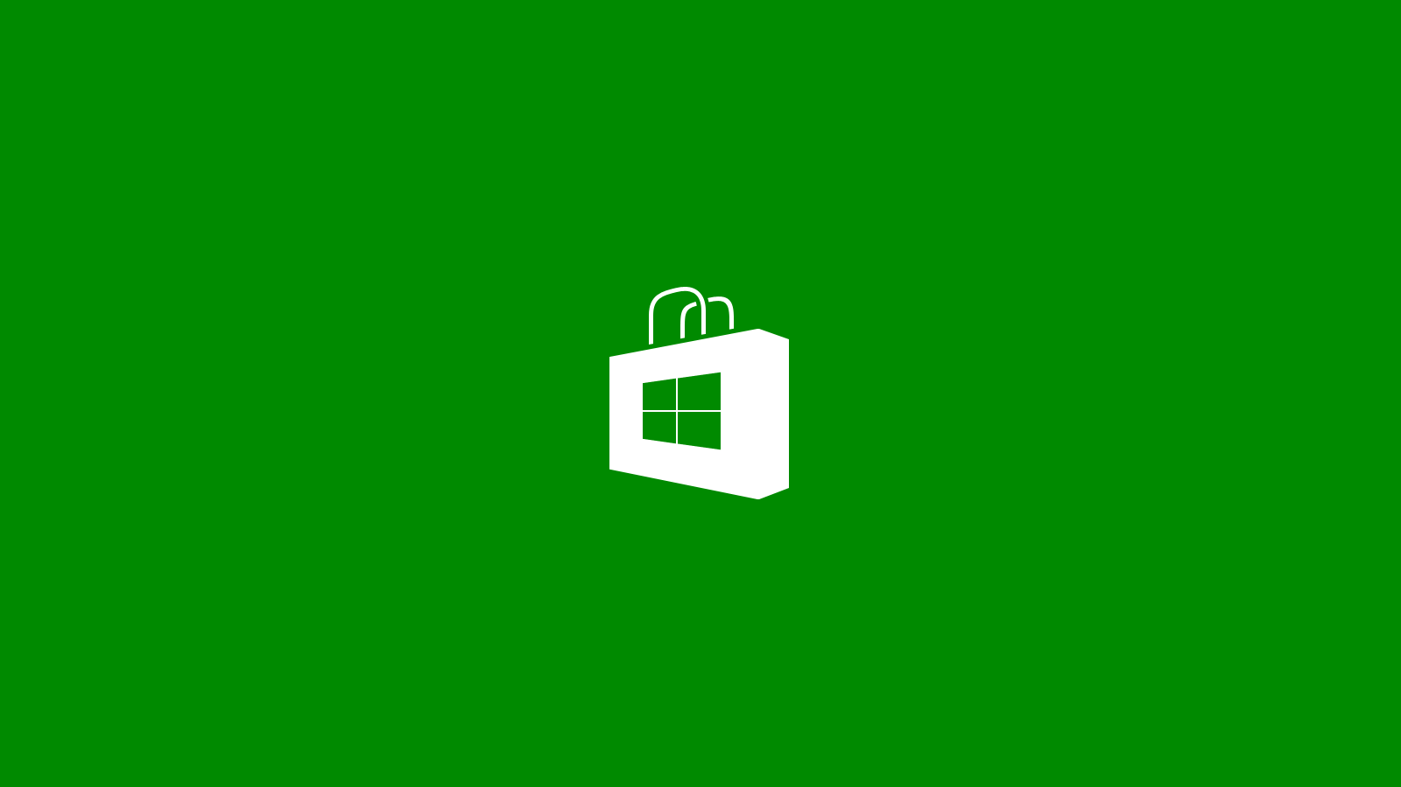


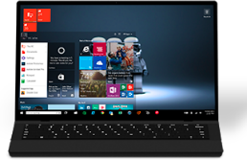
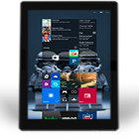
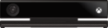

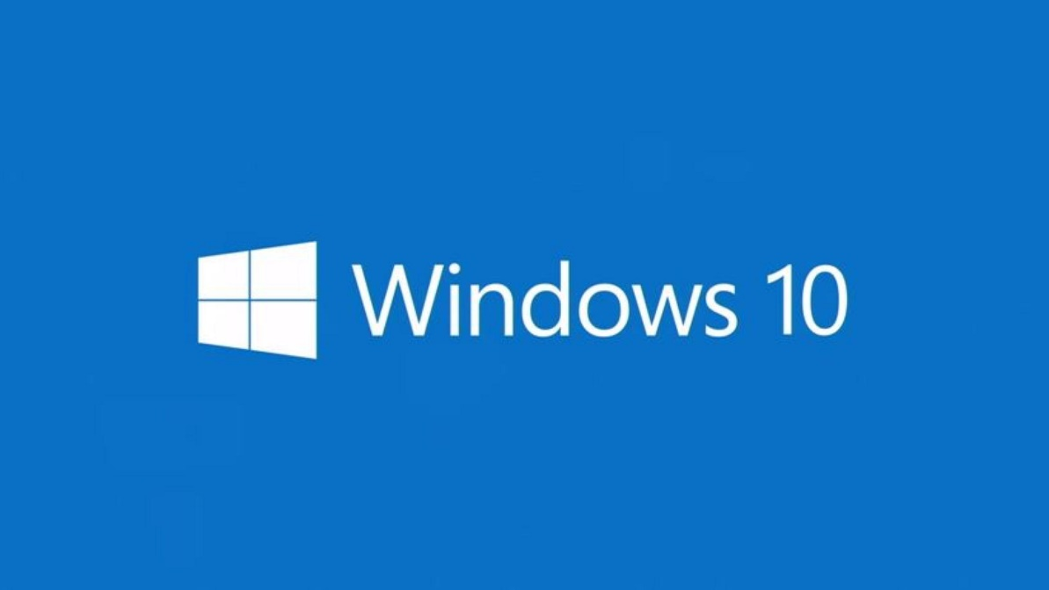
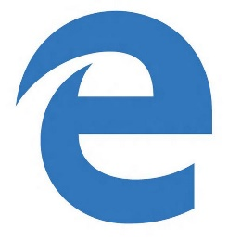
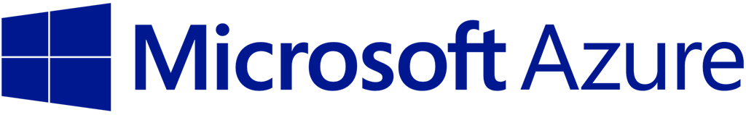
High-Level Architecture of Modern App
Notes:
Рассказываем про то, что в современном мире очень важен как код, работающий в облаке, так и код, работающий на разных клиентских устройствах. Майкрософт – единственная компания, которая контролирует платформу как в облаке, так и на различных клиентах (ПК, таблет, смартфон, гостиная, устройства)

Slide 7


Microsoft is Ideal Platform to Learn App Dev
C#
One Language Everywhere Client devices (incl. IoT) and the Cloud
Simple!
Students of the middle school can create their applications
Excellent Tooling
The best-in-class tools for development, team work, etc.

Slide 8



Cross-Platform Development on MS Technologies
iOS, Android, Windows
Cross-Platform Development using HTML/JS from Visual Studio
iOS, Android, MacOS, Windows
Using C# to target all platforms
iOS, Android, MacOS, Windows
2D/3D Games using C#

Slide 9
This Course is just the beginning…
Creating Modern Apps on Microsoft Platform
Universal App Development for Beginners
Deep Dive into Universal Windows Platform
Developing Microsoft Azure Applications and Services for Beginners
…

Slide 10

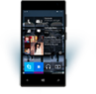

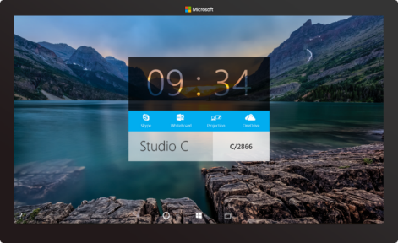
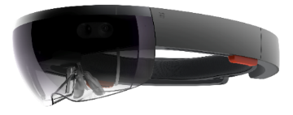
IoT
SmartPhone
Tablet
Notebook
Desktop PC
Windows 10
Surface Hub
Xbox
Hololens
Notes:
Windows 10 runs on a wide variety of devices, from phones with a 4.5” screen, through phablets, tablets, PCs, laptops, convertibles such as the Surface, on desktops and All-in-ones, to the Xbox in your living room and right up to giant 84” screens such as our team collaboration device, the Surface Hub. And it also takes in very tiny cheap computers such as the Raspberry Pi 2, and innovative hardware such as the Hololens.

Slide 11
What’s in this Course
Video Lectures
Theoretical Material + Demos
Code Samples
http://github.com/evangelism/Win10UWPCourse
Lab Assignments
Assignments are quite vague, so that you can chose something which interests you
For some Labs we provide solutions on GitHub
However, we highly recommend to do labs on your own, otherwise you will not be able to learn as effectively

Slide 12
After completing the course:
You will be able to create typical applications on Universal Windows Platform (Windows 10, Windows 10 Mobile)
We will discuss the design principles to target different form-factors
Working on the series of Labs you can come up with your own capstone project, which we recommend to publish in the marketplace
We will consider cloud backend, network connected apps, sensors, IoT, etc. in the next part of the course

Slide 13
Other Useful Materials
Official Platform Samples
https://github.com/Microsoft/Windows-universal-samples
https://github.com/ms-iot/samples
Unofficial Samples
http://github.com/evangelism/HackSamples
http://dev.windows.com

Slide 14
Let’s Start!

Slide 15

Contact
Dmitry Soshnikov
Microsoft
dmitryso@microsoft.com & vk.com/shwars
blogs.msdn.com/sos & blog.soshnikov.com
twitter: @shwars

